Slide 1
Xinhang Xu
Major in Plasma Physics (Ph.D.)
Apply Position: Electron Kinetics of Microwave Current Drive
Job reference: 14591
Phone: (+1)5309793691
Email : xihxu@ucdavis.edu
Xinhang Xu

Slide 2
Education and Research Activities
2016 – 2023 University of Science and Technology of China, EAST
Ph.D. Major in Plasma Physics
Dissertation Title: Numerical Study of the Kinetic Evolution of Non-thermal Electrons in Tokamak and its Influence on Cyclotron Radiation
(1) Plasma theory model development, (2) Diagnostics development and application,
(3) Physics campaign and data interpretation, (4) Model validation
2023 – 2025 University of California at Davis, NSTX-Upgrade
Postdoc, Spherical Tokamak Physics Study and Diagnostics Development
(1) Laser-based and microwave-based diagnostics development
(2) Young research mentoring and training program
Self Introduction

Slide 3
Research Activities:
Plasma Theory & Experimental Study
Plasma Theory and Experimental Study

Slide 4
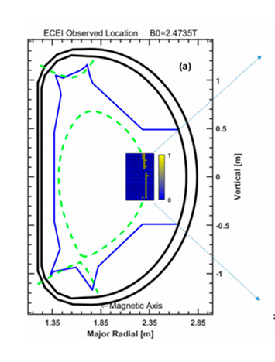
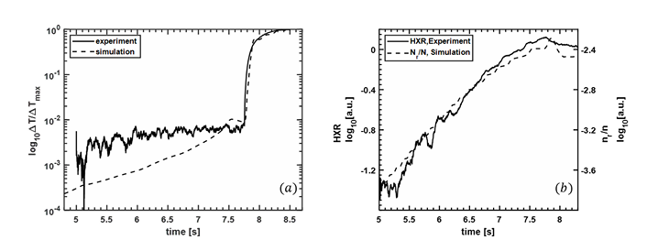
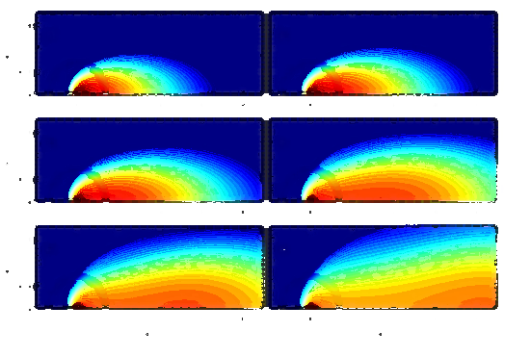
Research Activities:
Plasma Theory & Experimental Study
Non-thermal Electron confinement with Magnetic Perturbations
Utilizing Electron Velocity Distribution Measurements for Enhanced Tokamak Startup Control
Validation of Kinetic Simulation and Synthetic Model
Plasma Theory and Experimental Study

Slide 5
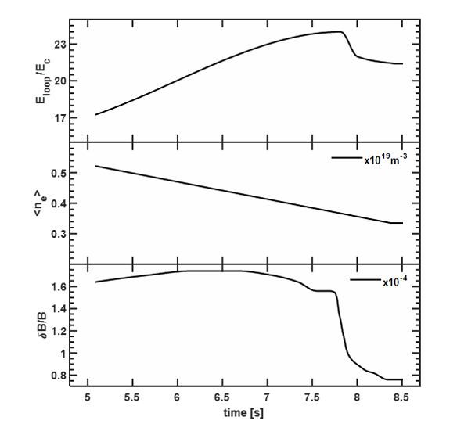
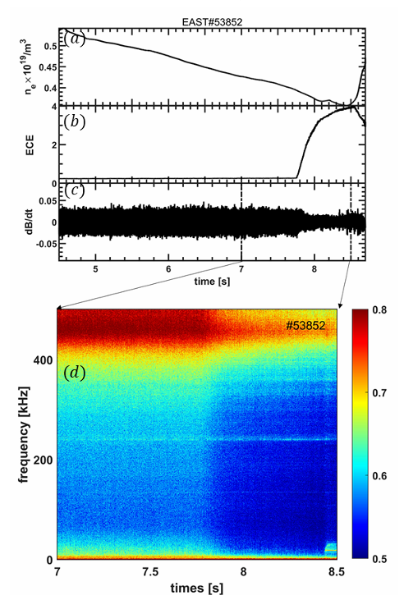


Research Activities:
Non-Thermal Electron emission with/without stochastic Magnetic Perturbations
How to understand sudden rise ECE emission?
Input data from experiment
Kinetic simulation
C[f]:Fokker-Plank collision operator
$\frac{∂}{∂p}⋅F_{rad}f$: Radiation damping operator
D[f]: Electromagnetic wave scattering operator
$S_{A}\left[f\right]:$ Avalanche operator
$S_{T}\left[f\right]:$ electron source with thermal distribution
L[f] : Magnetic perturbation loss operator (Harvey model)
Comparison of output parameters with experimental data
Plasma Theory and Experimental Study (2/4)
synthetic diagnostic module
Simulate the Electron cyclotron emission based on the electron velocity distribution
Background & Motivation
Theory & Model
Experimental Study & Validation

Slide 6
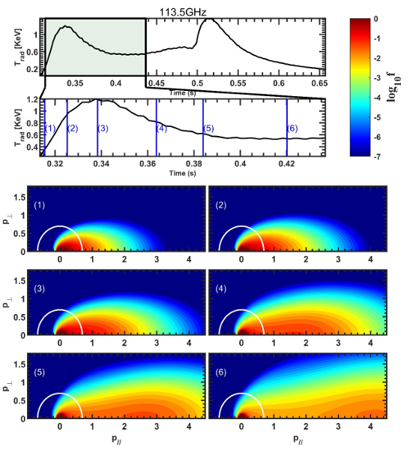
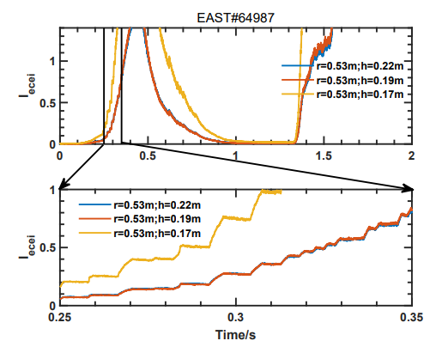
Research Activities:
Electron Velocity Distribution during Tokamak Startup
Kinetic Simulation
Velocity Distribution Calculation
EAST#64987
C[f] : Folk-plank collision operator
S_{A}[f]:Avalanche collision operator
Plasma Theory and Experimental Study (3/4)
Synthetic Diagnostic Module
Simulate the Electron cyclotron emission based on the electron velocity distribution
Experimental data from the EAST tokamak, including electric field, density, and temperature during startup, are used to validate the computed electron velocity distribution function.
The code is released on GitHub.
Background & Motivation
Theory & Model
Experimental Study
Notes:
Results: Avalanche process lead to the abnormal emission while the anomalous doppler effect lead to the step structure (Xinhang Xu et al 2025 Chinese Phys. B)

Slide 7
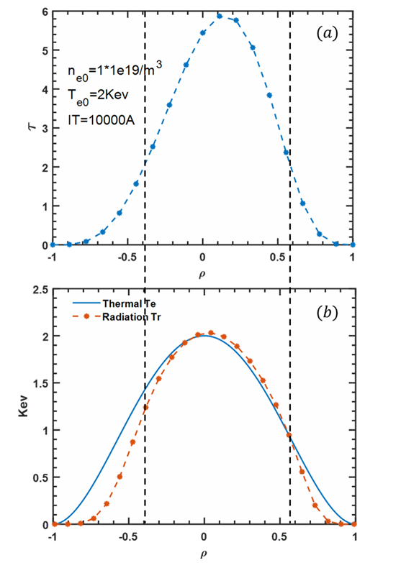
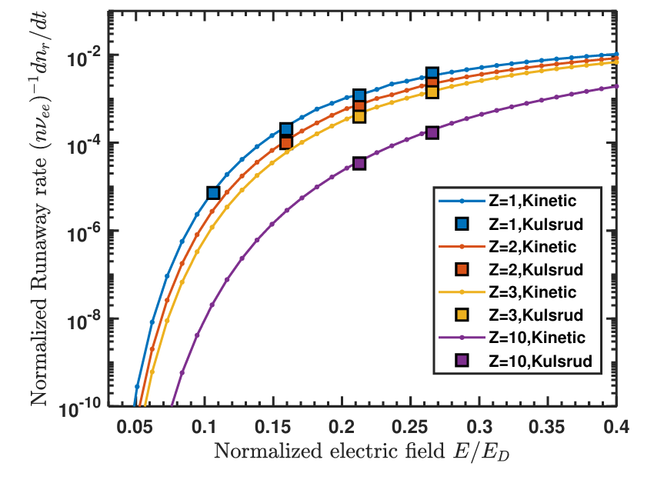
Research Activities:
Validation of Kinetic Simulation and Synthetic Model
Growth Rate of Runaway Electron Density in the Kinetic Model
Synthetic Model
Validate the agreement between electron temperature and radiation temperature by synthetic model.
Kinetic Model
Previous Model
Plasma Theory and Experimental Study (4/4)
Electron Temperature
Radiation Temperature
Validate the runaway electron growth rate with previous model (Kulsrud, PRL,1973)
Notes:
Results: Avalanche process lead to the abnormal emission while the anomalous doppler effect lead to the step structure (Xinhang Xu et al 2025 Chinese Phys. B)

Slide 8
Research Activities:
Plasma Theory & Experimental Study
Confinement Improvement by Understanding Micro-Tearing Modes in ELMs
Non-thermal Electron confinement with Magnetic Perturbations
Utilizing Electron Velocity Distribution Measurements for Enhanced Tokamak Startup Control
Validation of Kinetic Simulation and Synthetic Model
Plasma Theory and Experimental Study

Slide 9
Programming and Automation
Programming and Automation

Slide 10
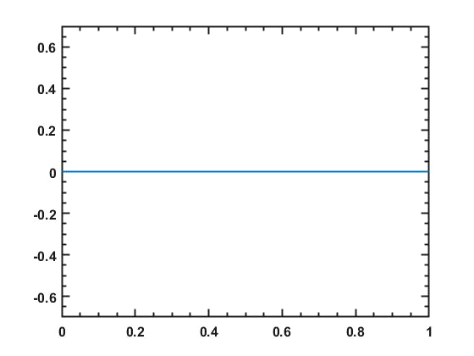
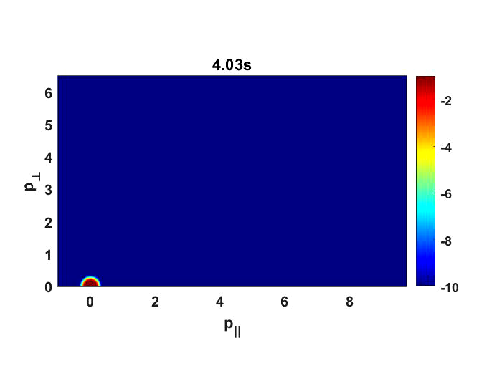
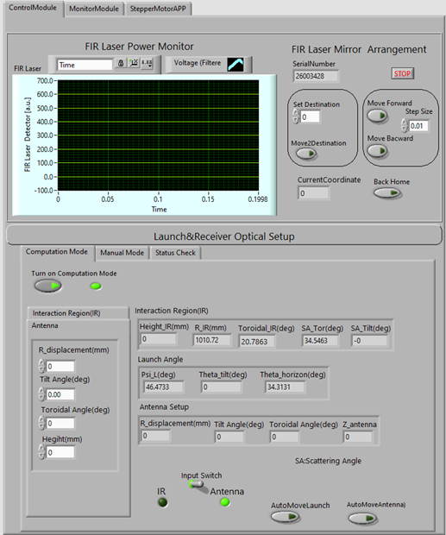
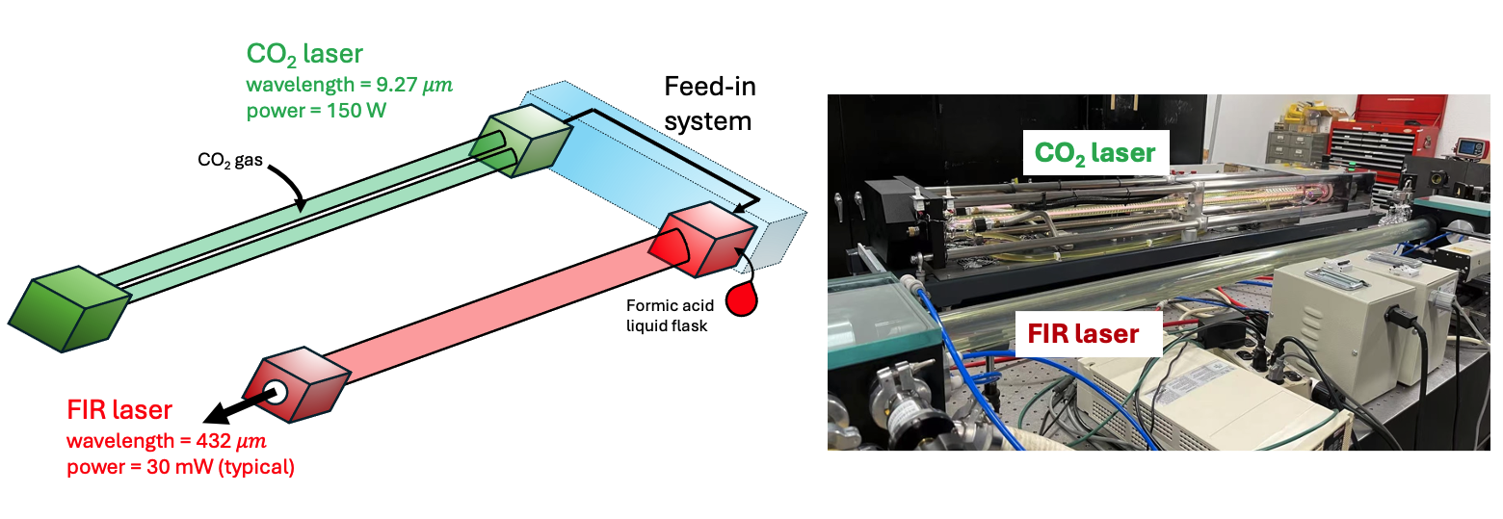
Programming and Automation
MATLAB (Released in 2024)
MATLAB (Released in 2018)
Diagnostic Signal vs. Time
Velocity distribution vs. Time
MATLAB (Released in 2018)
3D Ray Tracing
Programming and Automation
LABVIEW + PYTHON (Released in 2025)
Diagnostic Auto-Calibration and Control
1.3D ray-tracing : https://git.lug.ustc.edu.cn/XuXinhang/ray-tracing3d.git
2.Kinetic + synthetic simulation: https://git.lug.ustc.edu.cn/XuXinhang/kinetic_simulation.git

Slide 11


Programming and Automation
7
8,000 +
4
Years Experience
Lines for Scientific Research
Plasma Physics Model Development (Leader)
PRIMARY
1.5
1,000 +
2
Programming and Automation
Years Experience
Lines for Scientific Research
Ray Tracing Calculation and Diagnostics Hardware Controller

Slide 12

"I am excited by the prospect of contributing to new fusion future."
Xinhang Xu
xihxu@ucdavis.edu

Slide 13
Research Activities:
Non-Thermal Electron Confinement with Magnetic Perturbations
Kinetic Simulation
Validation
For better non-thermal electron confinement, it requires understanding of non-thermal electron emission
EAST #53864
Measurement
PARTICLE CONFINEMENT
L[f] : Magnetic perturbation loss operator (Harvey model[1])
REF:
Simulation
Enhanced control of non-thermal electrons leads to improved particle confinement and higher fusion efficiency.
Plasma Theory and Experimental Study (2/4)
Synthetic Diagnostic Module
Non-thermal emission directly reveals the spatial and energy distribution of non-thermal electrons, providing a measure for assessing particle confinement.
Simulate the Electron cyclotron emission based on the electron velocity distribution
The measured proportion of non-thermal electrons validates that the theoretical calculations are in well agreement with experimental results.
The code is released on GitHub.
Background & Motivation
Theory & Model
Experimental Study & Validation
1.Harvey, R. W., et al. Physics of Fluids B: Plasma Physics 5.2 (1993): 446-456.

Slide 14
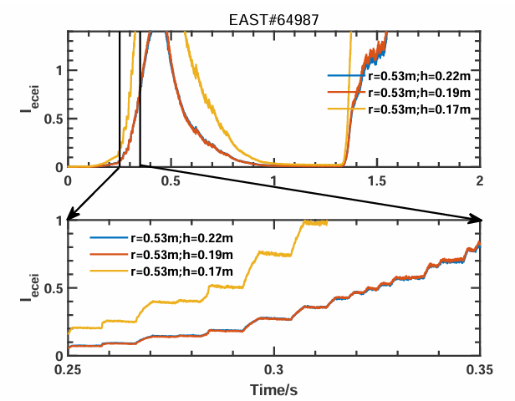

Research Activities:
Utilizing Electron Velocity Distribution Measurements for Enhanced Tokamak Startup Control
Simulation results from experiment
Abnormal increase of ECE emission and step structure in the rise phase
Kinetic simulation
C[f]:Fokker-Plank collision operator
$\frac{∂}{∂p}⋅F_{rad}f$: Radiation damping operator
D[f]: Electromagnetic wave scattering operator
$S_{A}\left[f\right]:$ Avalanche operator
$S_{T}\left[f\right]:$ electron source with thermal distribution
L[f] : Magnetic perturbation loss operator (Harvey model)
Plasma Theory and Experimental Study (2/4)
synthetic diagnostic module
Simulate the Electron cyclotron emission based on the electron velocity distribution
Background & Motivation
Theory & Model
Experimental Study & Validation
Notes:
Results: Avalanche process lead to the abnormal emission while the anomalous doppler effect lead to the step structure (Xinhang Xu et al 2025 Chinese Phys. B)

Slide 15
Research Activities:
Utilizing Electron Velocity Distribution during Tokamak Startup
Kinetic Simulation
Velocity Distribution Calculation
The velocity distribution function, derived from emission measurements, is utilized in a feedback control system during plasma startup to optimize heating efficiency.
EAST#64987
VELOCITY DISTRIBUTION
By controlling the velocity distribution, heating efficiency during plasma startup can be enhanced, thereby reducing the cost of plasma ignition.
C[f] : Folk-plank collision operator
S_{A}[f]:Avalanche collision operator
Plasma Theory and Experimental Study (3/4)
Leveraging existing facilities and diagnostic tools, this study aims to measure and understand the electron velocity distribution functions across different startup scenarios, in order to develop optimized control strategies.
Synthetic Diagnostic Module
Simulate the Electron cyclotron emission based on the electron velocity distribution
Experimental data from the EAST tokamak, including electric field, density, and temperature during startup, are used to validate the computed electron velocity distribution function.
The code is released on GitHub.
Background & Motivation
Theory & Model
Experimental Study
Notes:
Results: Avalanche process lead to the abnormal emission while the anomalous doppler effect lead to the step structure (Xinhang Xu et al 2025 Chinese Phys. B)

Slide 16
Research Activities:
Module validation
Synthetic Model
Kinetic Model
Check if the radiation temperature close to thermal temperature under optical thick condition
Plasma Theory and Experimental Study (2/4)
Compare the runaway electron growth rate with previous results (Kulsrud, PRL,1973) under same condition
R2
Notes:
Results: Avalanche process lead to the abnormal emission while the anomalous doppler effect lead to the step structure (Xinhang Xu et al 2025 Chinese Phys. B)

Slide 17
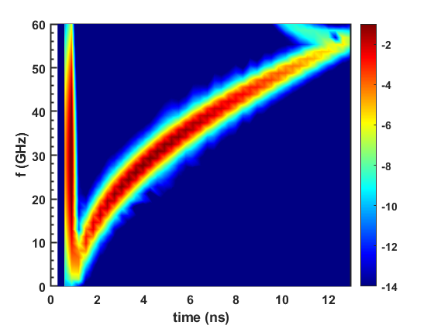
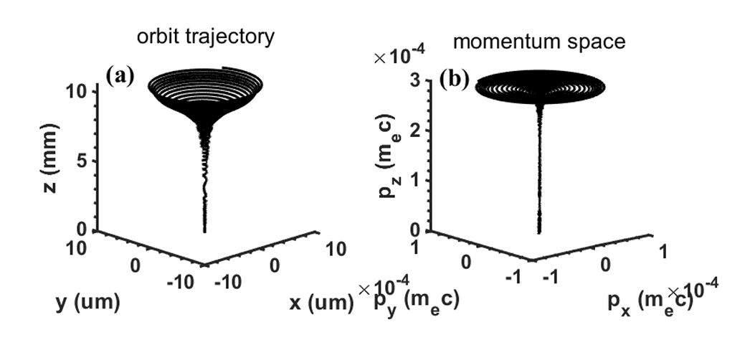
Programming and Automation
Kinetic + synthetic simulation (+2000 lines)
1D-FDTD simulation in plasma for USPR(+2000 lines)
3D ray-tracing simulation (450 lines)
Wave-particle resonant simulation (+500 lines)
Programming and Automation
1.3D ray-tracing : https://git.lug.ustc.edu.cn/XuXinhang/ray-tracing3d.git
2.Kinetic + synthetic simulation: https://git.lug.ustc.edu.cn/XuXinhang/kinetic_simulation.git
3.2D fdtd simulation : https://git.lug.ustc.edu.cn/XuXinhang/fdtd_2d.git

Slide 18

Programming and Automation
High-k laser and TIReTIP(Far-infrared tangential interferometer/polarimeter) diagnostic control and monitor for NSTX-U
Control platform
Programming and Automation
control
monitor
Receive optical adjustment
Launch optical adjustment
System temperature
Optical position
Laser Cavity adjustment
Laser power
feedback
Frequency

Slide 19
